Slide 1

GAN (Generative adversarial networks)
A generative adversarial network is a class of machine learning frameworks invented by Ian Goodfellow and his colleagues in 2014. Two neural networks contest with each other in a game. Given a training set, this technique learns to generate new data with the same statistics as the training set.

Slide 2
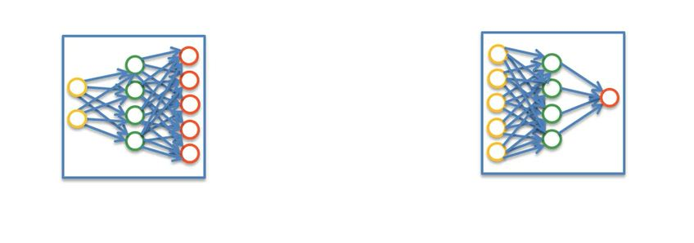
GAN, has two Components …
G and D

Slide 3
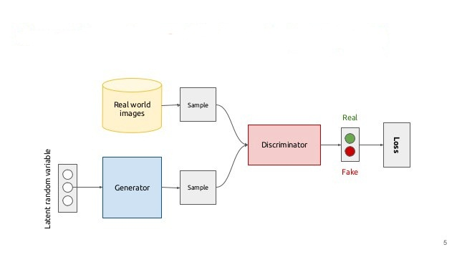
GAN, Architecture and Working

Slide 4
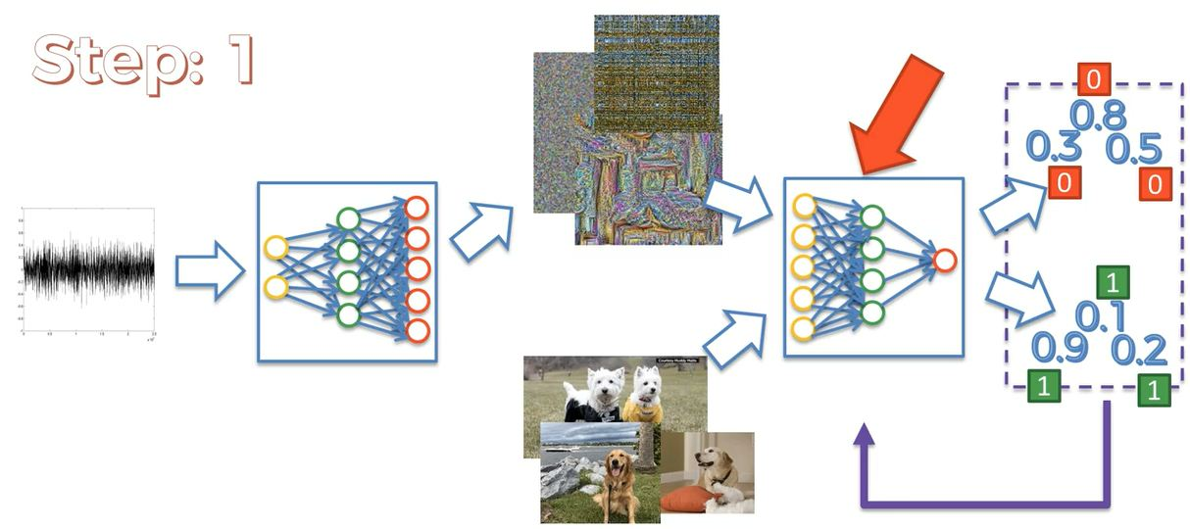
GAN, Working STEP:01

Slide 5
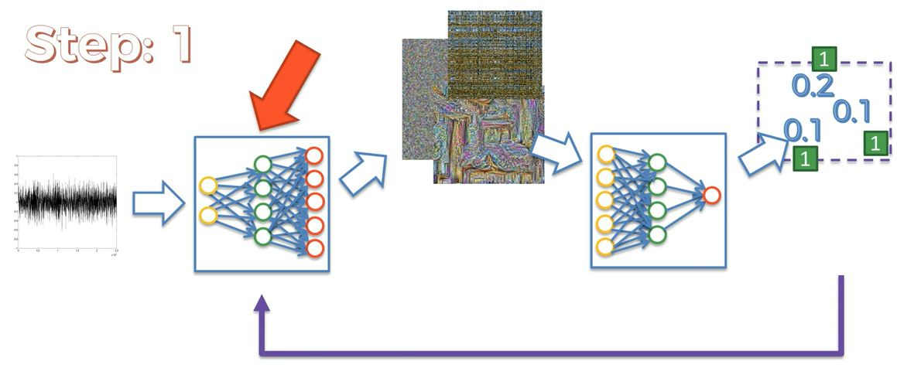
GAN, Working STEP:01

Slide 6
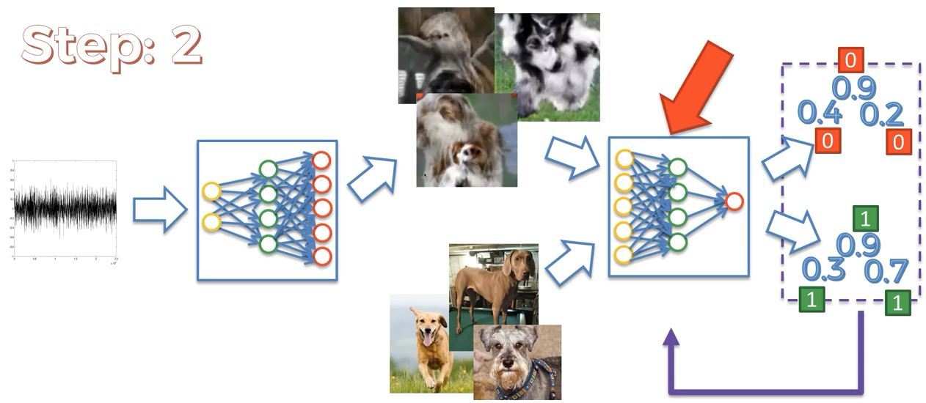
GAN, Working STEP:02

Slide 7
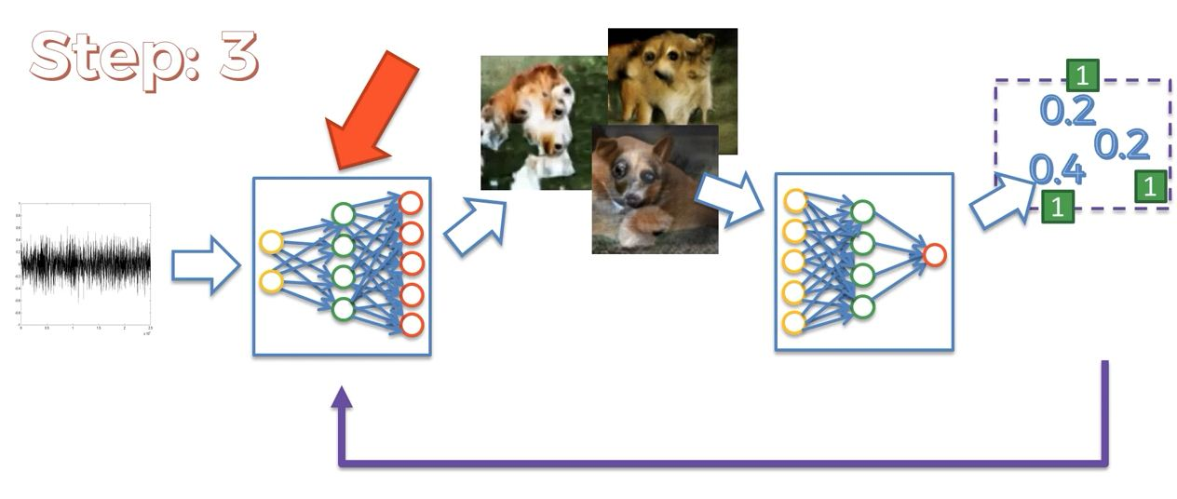
GAN, Working STEP:03

Slide 8
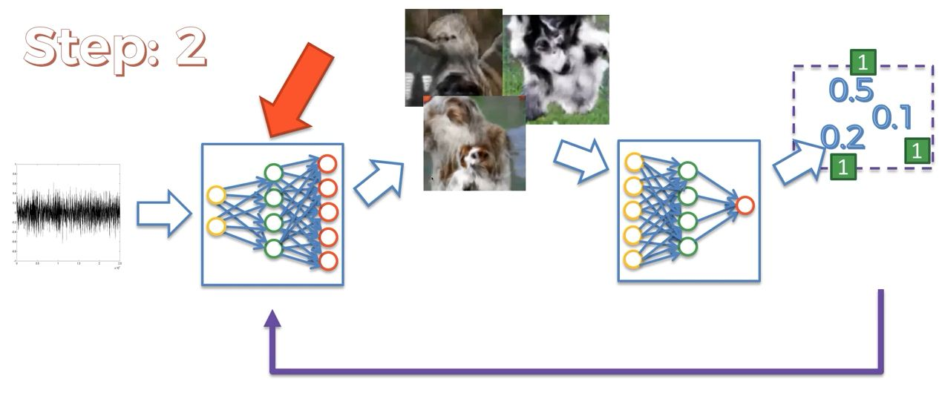
GAN, Working STEP:02

Slide 9
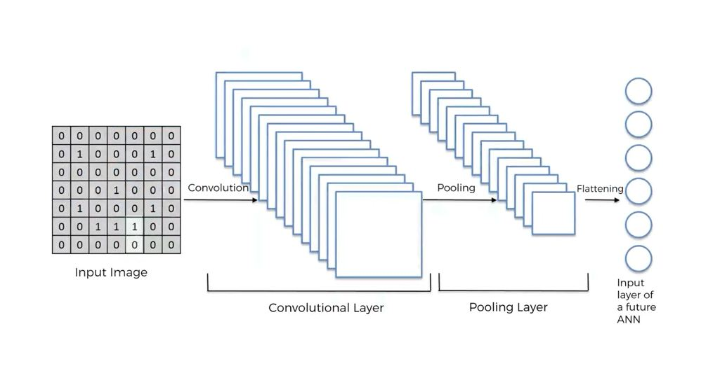
CNN VS D-CNN

Slide 10
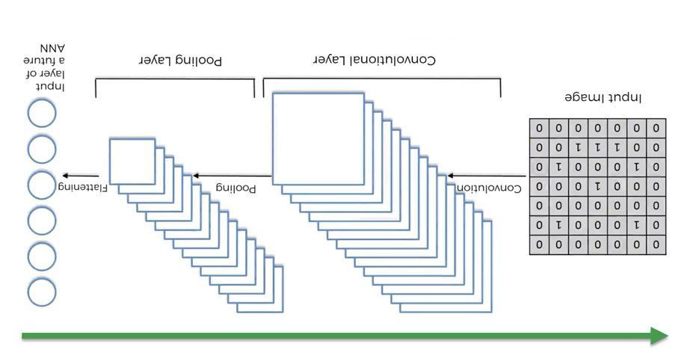
CNN VS D-CNN

Slide 11
THANKS,
DO SUBSCRIBE, LIKES AND SHARES….

Slide 12
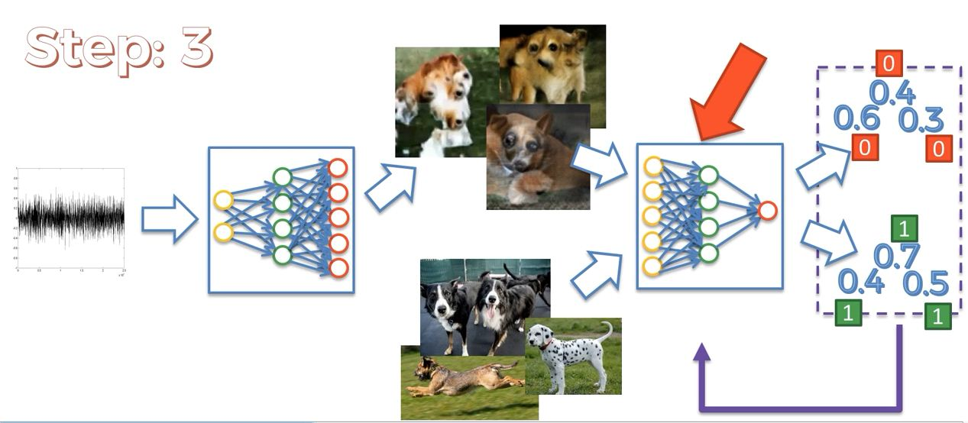
GAN, Working STEP:03

Slide 13
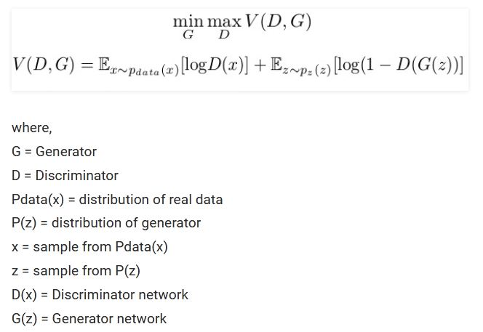
Loss function of GAN

Slide 14
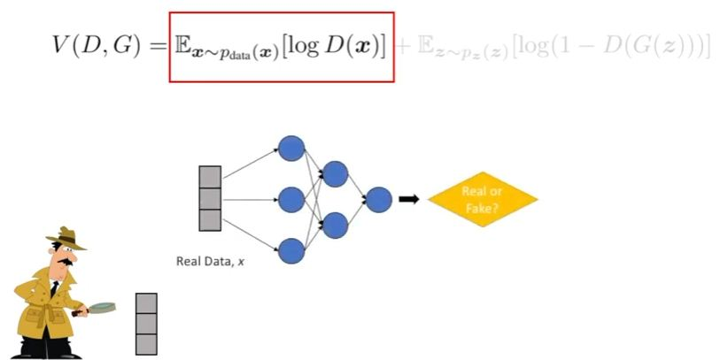
Loss function of GAN

Slide 15
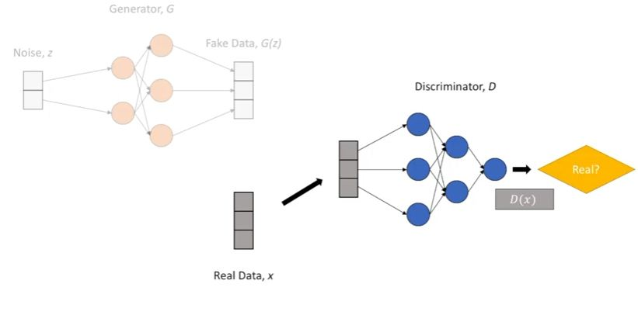
Loss function of GAN

Slide 16
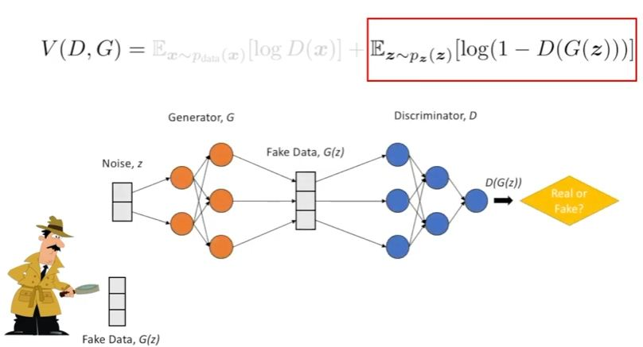
Loss function of GAN

Slide 17
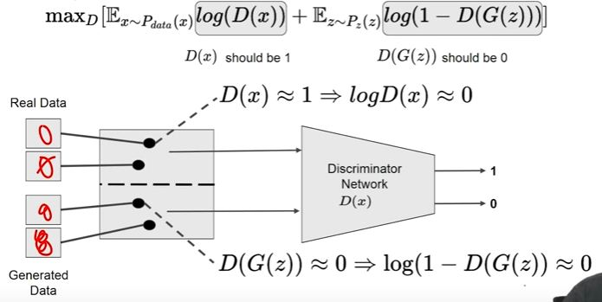
Into depth, GAN function

Slide 18
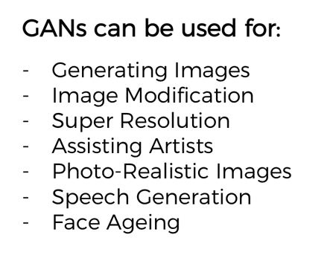
Application of GAN

Slide 19
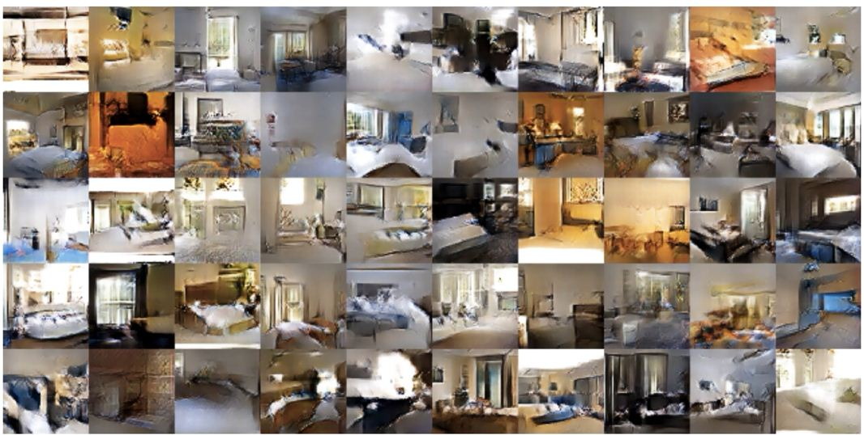
Application of GAN

Slide 20
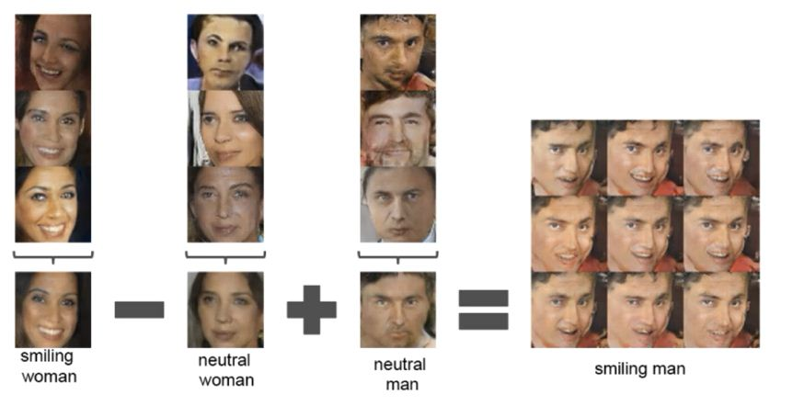
Application of GAN

Slide 21
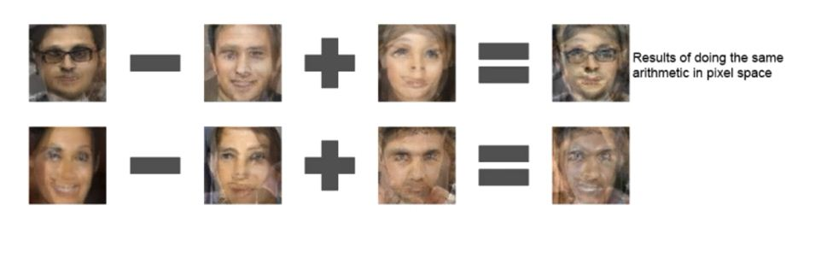
Application of GAN

Slide 22
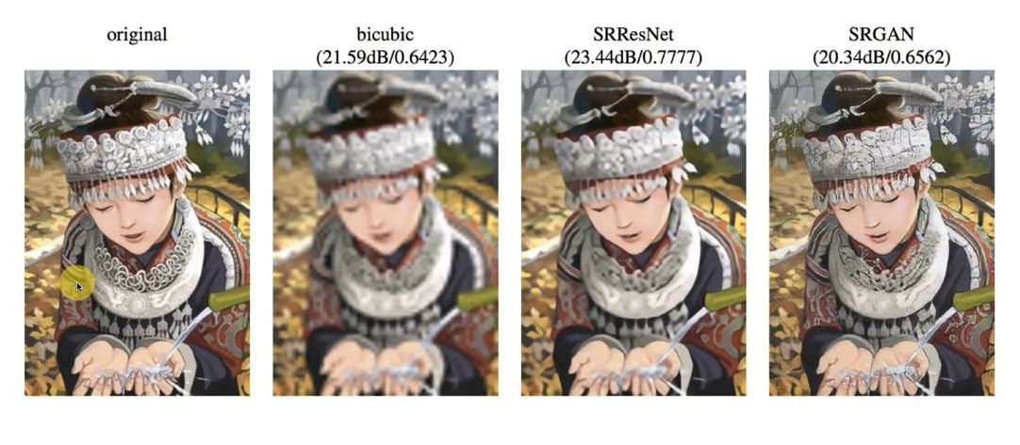
Application of GAN

Slide 23
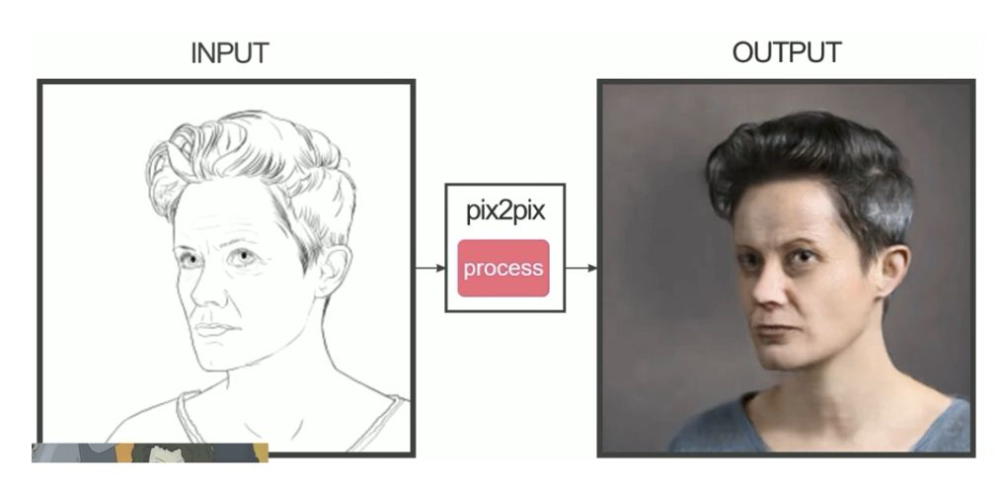
Application of GAN

Slide 24
Additional Reading
link:
Paper: Generative Adversarial Nets (Ian J. Goodfellow)
https://machinelearningmastery.com/what-are-generative-adversarial-networks-gans/
Do Subscribe, like and Share...

Slide 25
Types of GAN:
Vanila GAN
Deep Convolutional GANs (DCGAN) ...
Conditional GANs (CGAN) ...
Super Resolution GAN
info GAN

Slide 26

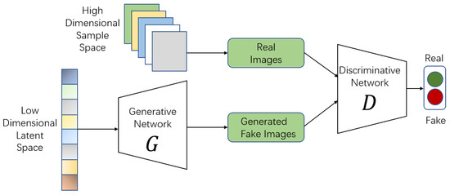
Vanila GAN

Slide 27
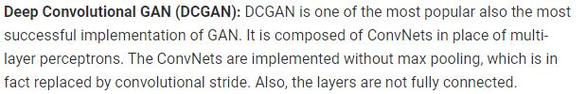
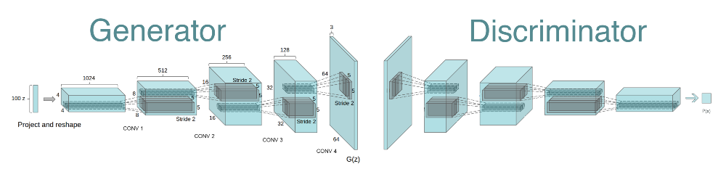
DC GAN

Slide 28
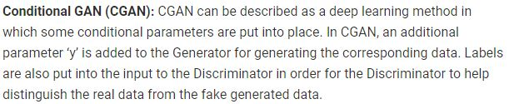
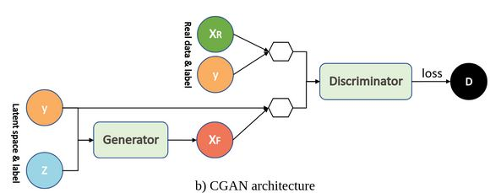
Conditional GAN

Slide 29
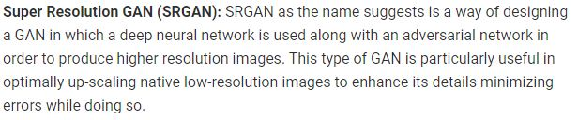
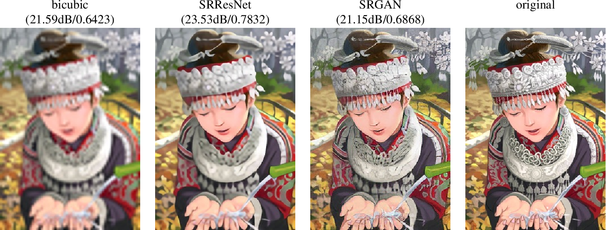
Super Resolution GAN

Slide 30
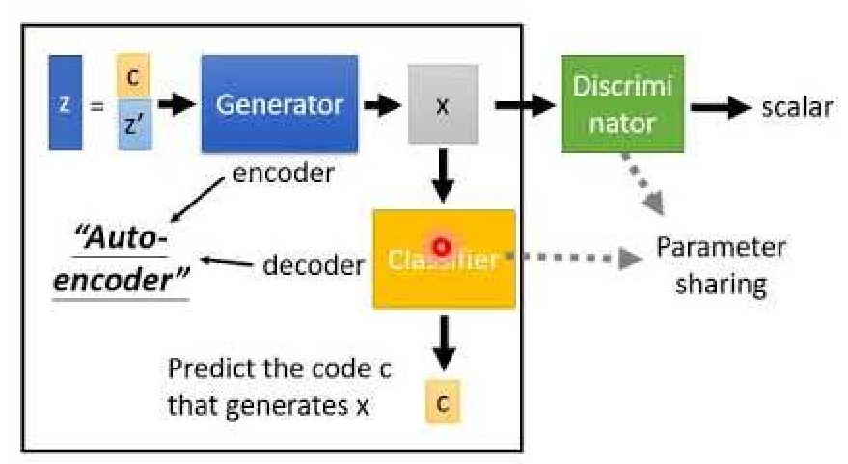
Info GAN
InfoGAN is a generative adversarial network that also maximizes the mutual information between a small subset of the latent variables and the observation. We derive a lower bound to the mutual information objective that can be optimized efficiently, and show that our training procedure can be interpreted as a variation of the Wake-Sleep algorithm

Slide 31
Thanks
Subscribe, like and Share...

